Slide 1

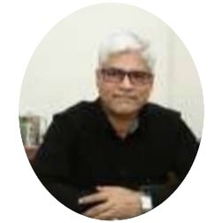
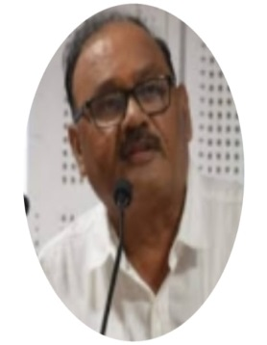

B.A.COLLEGE OF ENGINEERING & TECHNOLOGY
Ghutia, Dist.East Singhbhum, Jharkhand
Approved By AICTE & Affiliated to Jharkhand University of Technology
WEBINAR ON
“RENEWABLE ENERGY-INDIAN SCENARIO”
ON THE OCCASION OF “WILLIAM THOMSON”BIRTHDAY
GUEST OF HONOUR
DR.SHIO KUMAR SINGH
CHAIRMAN,BACET,JHARKHAND
CHIEF GUEST & SPEAKER
DR.P.K.MISHRA
VICE CHANCELLOR,
JHARKHAND UNIVERSITY OF TECHNOLOGY
DATE: SATURDAY 26TH JUNE 2021
TIME: 11:30 AM ONWARDS
Link To Join (GOOGLE MEET)
https://meet.google.com/asf-jnom-uiw
ORGANIZED BY
DEPARTEMENT OF ELECTRICAL & ELECTRONICS ENGINEERING BACET,JAMSHEDPUR
Free Registration for All & E-Certificate will be provided for all active participants
(If you have any queries feel free to contact : E-Mail : hod.eee.bacet@gmail.com or 7488689290)

